Slide 1

COURIER MANAGEMENT SYSTEM
NAME: M.BINDU MADHAVI
ROLL NO: 2341111
GUIDE NAME: NAGARAJU SIR

Slide 2
ABSTRACT:
This courier management system provides a digital platform that simplifies the process of parcel booking, tracking, dispatching, and delivery management for courier companies.
This structured around three main user roles: Admin, Staff, and Customer.
Customers can register, book shipments, and track their parcels in real-time.
Staff can manage parcel status, assign deliveries, and update shipment progress.
The Admin has full control over the system, including managing users, viewing reports, and overseeing parcel logistics.

Slide 3
INTRODUCTION:
The Courier Management System is developed to address these challenges by providing an automated solution for managing courier operations.
This system is designed to streamline various processes involved in courier services such as parcel booking, tracking, dispatching, delivery confirmation, and record-keeping.
By integrating these functionalities into a single digital platform, the system enhances both operational efficiency and customer experience.

Slide 4
EXISTING SYSTEM:
The current courier management processes in many organizations are often semi-automated or entirely manual.
Many small to mid-sized companies rely on paper-based logs and phone calls for booking and tracking parcels.
This traditional approach has several limitations, especially in handling a growing number of shipments and maintaining customer satisfaction.
Some use basic desktop or web applications, but these systems lack real-time tracking, automation, and integration with mobile apps or GPS.

Slide 5
PROPOSED SYSTEM:
The proposed system allows customers to book parcels online, generate tracking IDs instantly, and monitor the real-time status of their shipments.
It enables staff members to update parcel status, assign delivery personally, and manage daily tasks through an intuitive dashboard.
Customers can track parcels live, receive SMS/email notifications, and make payments online.
Delivery staff will use a mobile app for live delivery updates and digital proof of delivery (e.g., e-signature or photo).

Slide 6
SYSTEM ANALYSIS
FESABILITY ANALYSIS:
Technical Feasibility : The proposed system is technically feasible as it is developed using well-established technologies such as Python, SQLite/MySQL for database management, and optionally Tkinter, Flask, or Django for the user interface.
Schedule Feasibility : The system can be developed and deployed within a reasonable timeframe.
Legal Feasibility : The system complies with standard data privacy and security practices, ensuring that sensitive user information and parcel data are protected.

Slide 7
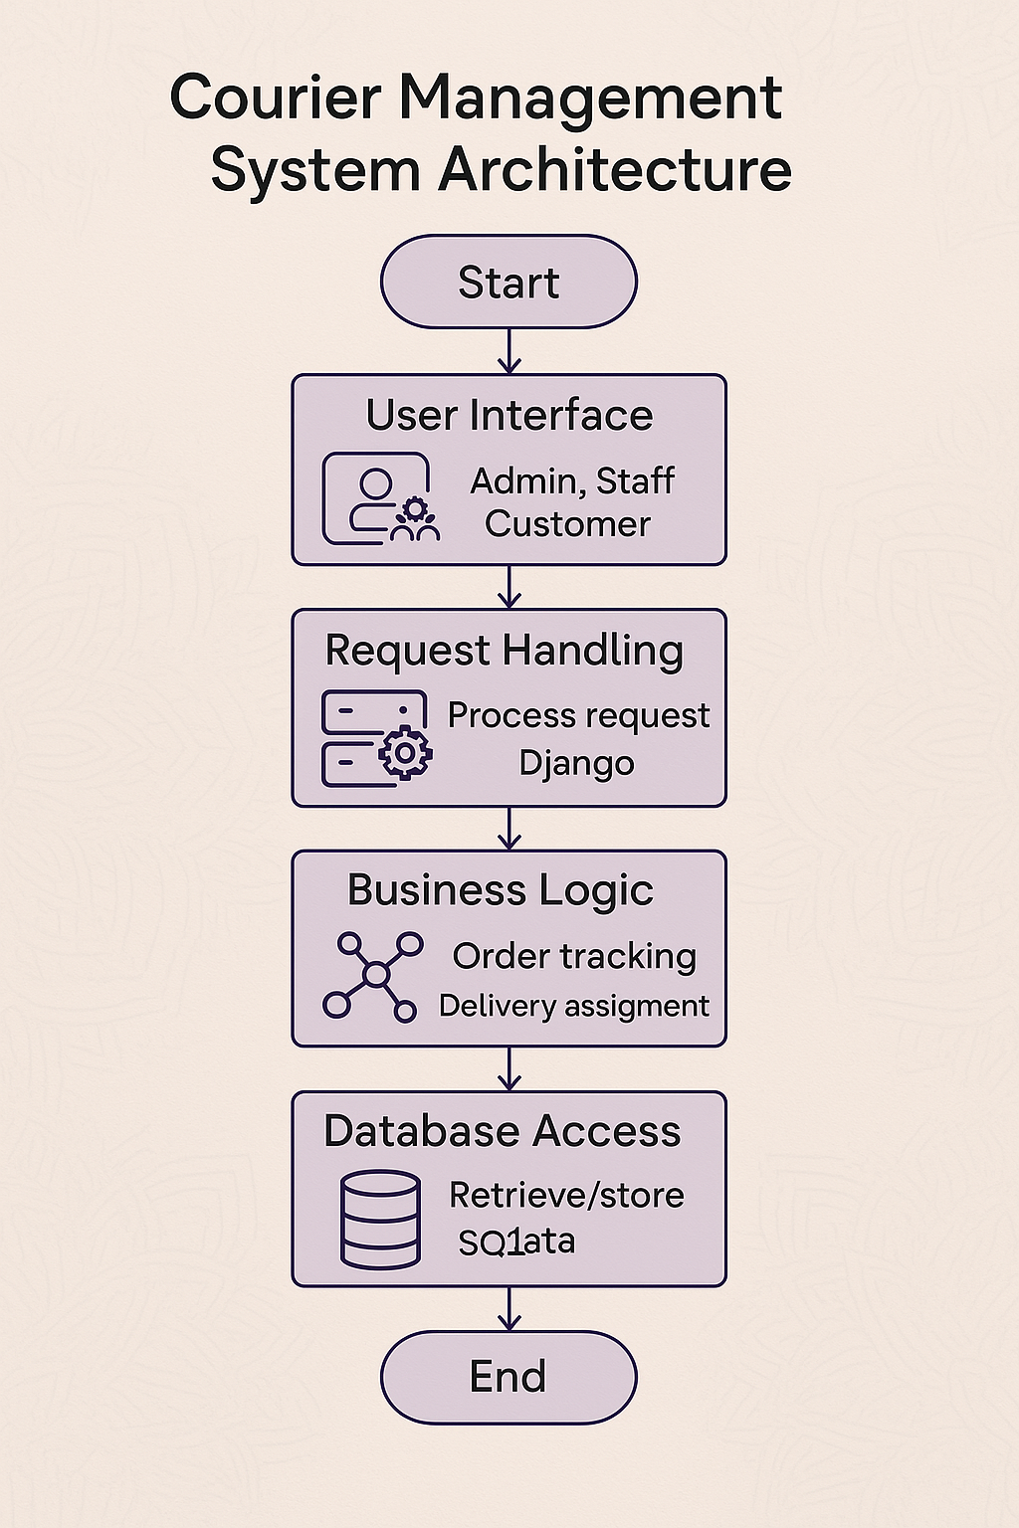
DESIGN
SYSTEM ARCHITECTURE:

Slide 8
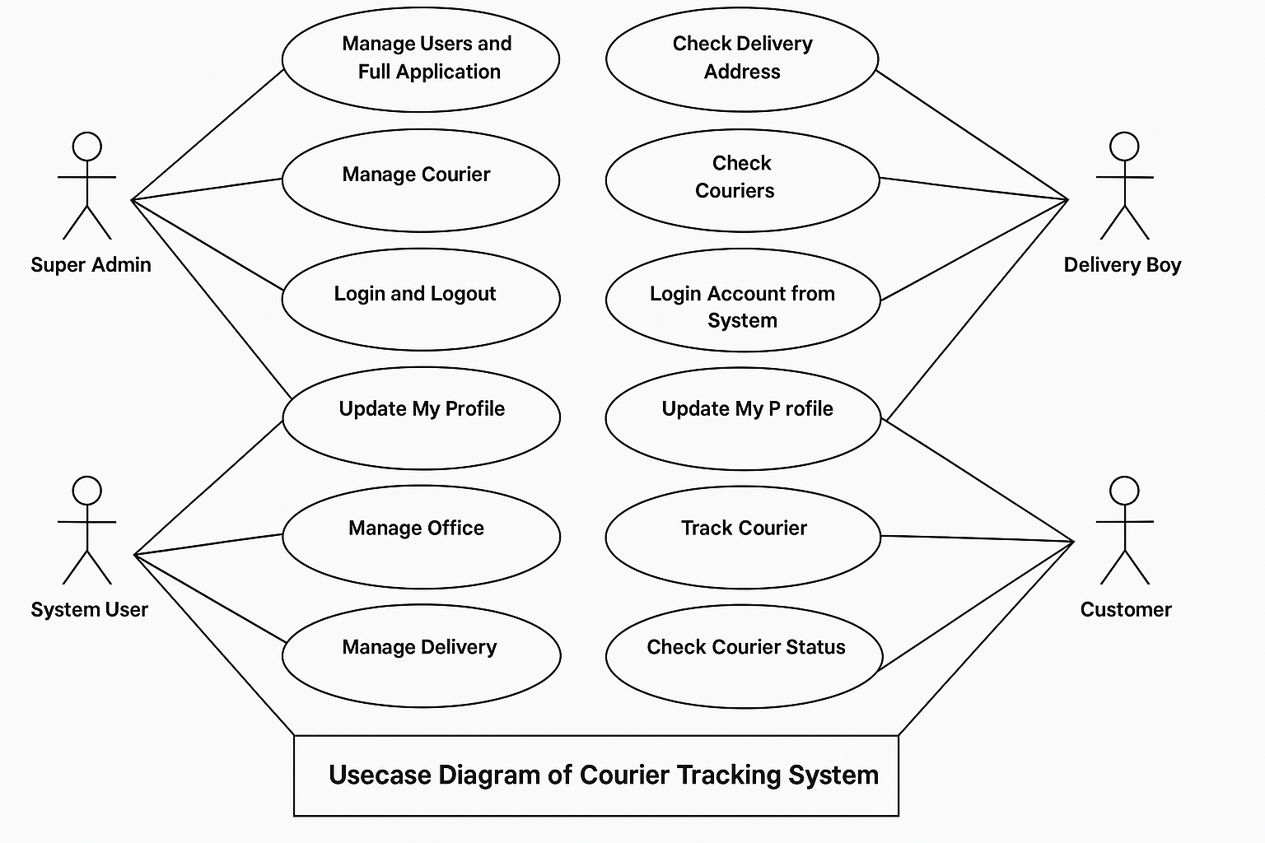
DESIGN
UML DIAGRAM – USECASE DIAGRAM

Slide 9
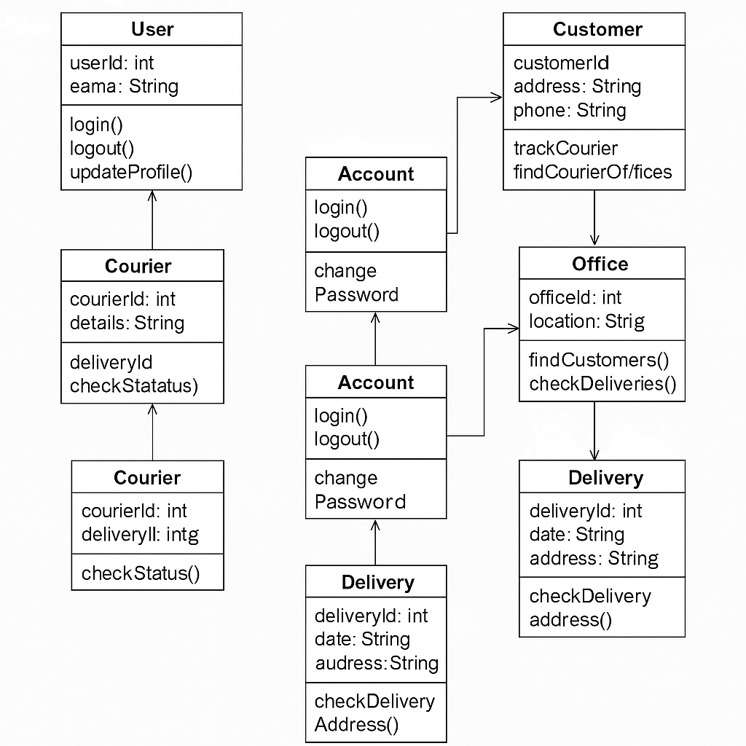
DESIGN
UML DIAGRAM : CLASS DIAGRAM

Slide 10
SYSTEM REQUIREMENTS
SOFTWARE REQUIREMENTS:
Operating System : Windows 10/11
Programming Language : Python 3.7
Frontened : Html
Backend : Django
Database : MySQL

Slide 11
SYSTEM REQUIREMENTS
HARDWARE REQUIREMENTS:
Processor : Intel Core i5
RAM : 8GB
Hard Disk : 250GB
System Type : 64-bit operating system

Slide 12
IMPLEMENTATION
MODULES:
User Authentication Module :
This Module Handles login/logout for all users (Admin, Customer, Delivery Boy, Manager).
Courier Management Module:
This Module Book new courier entries, Generate tracking numbers and Update courier status (Booked, In Transit, Delivered, etc.).
Customer Management Module :
This Module Add/edit customer details, View courier history for customers and Search couriers by customer ID or name

Slide 13
IMPLEMENTATION
MODULES:
Tracking Module :
This Module show Public or customer portal to enter tracking ID and Show current status and courier history estimated delivery date.
Delivery Management Module:
This Module to Assign couriers to delivery boys and Update delivery status.
To Track delivery locations (optional GPS integration).
Notification Module :
This Module to send Email/SMS alerts for status updates.

Slide 14
IMPLEMENTATION
INPUT DESIGN:
User Input Screens:
Sender Information are Name, address, contact details and email.
Receiver Information are Name, address, contact details, and email.
Payment Information are Payment details, including card information or other methods (e.g., cash on delivery).
Admin Input Screens:
Shipment Creations are Input from the admin to create new shipments, assign couriers, and update delivery statuses.
Courier Assignment of couriers to deliveries based on location, availability, and capacity.

Slide 15
IMPLEMENTATION
OUTPUT DESIGN:
Customer Output Screens:
Tracking Information are Real-time updates of the package status, delivery progress, and expected delivery time.
Notifications are Alerts regarding shipment status, delays, or completed deliveries (email, SMS, app notifications).
Admin Output Screens:
Package Status Detailed reports on the current status of all shipments (in transit, delivered, pending, etc.).
Courier Performance Reports are Assess the performance of individual couriers in terms of delivery speed, success rate, and customer satisfaction.

Slide 16
TESTING
TECHNOLOGY:
This project is developed using Python as the core programming language and utilizes the Django web framework to build a robust and scalable courier management system. The user interface is designed using HTML, CSS, and JavaScript, ensuring a responsive and interactive experience. For data storage, the project uses SQLite by default, with support for MySQL or PostgreSQL in production environments. The system integrates Google Maps API to track courier locations and display real-time routes on the map. Django’s built-in authentication is used for secure login functionality for both admins and employees. Additionally, tools like Bootstrap enhance the frontend design, and libraries such as Pandas may be used for efficient data handling and reporting..

Slide 17
TESTING
DEFINATION:
Testing in a Courier Management System refers to the systematic process of evaluating the software to ensure that all module
TYPES OF TESTING
UNIT TESTING:
Tests individual components or functions.
INTEGRATION TESTING:
Checks data flow and interaction between modules .
SYSTEM TESTING:
Validates the complete system as a whole.

Slide 18
TESTING
FUNCTIONAL TESTING:
Verifies that the system performs its intended functions.
SECURITY TESTING:
Identify vulnerabilities and ensure data protection.
REGRESSION TESTING:
Ensure new changes don’t break existing functionality.

Slide 19
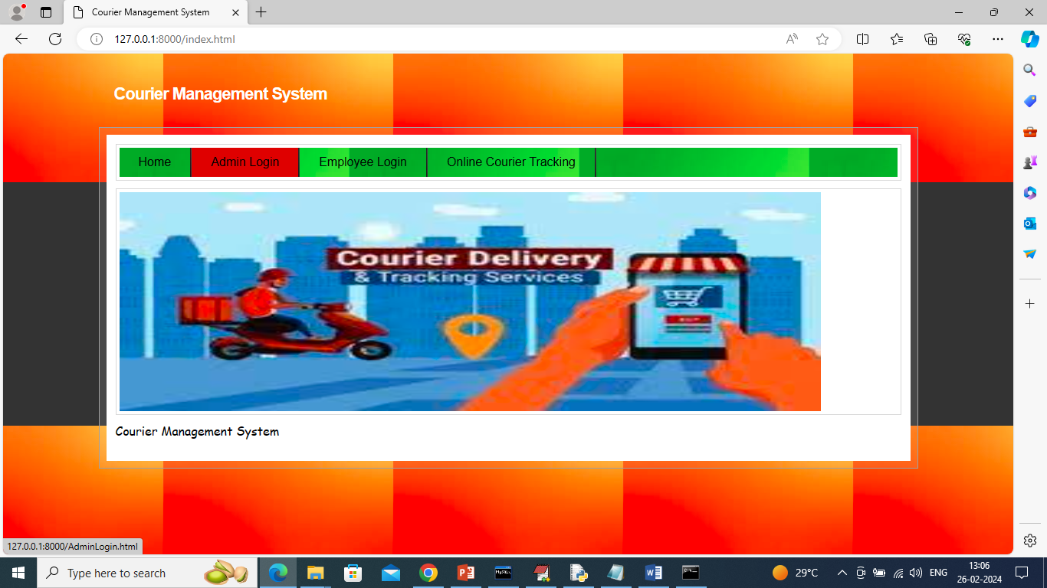
SAMPLE TESTING
SCREENSHOTS: HOME SCREEN

Slide 20
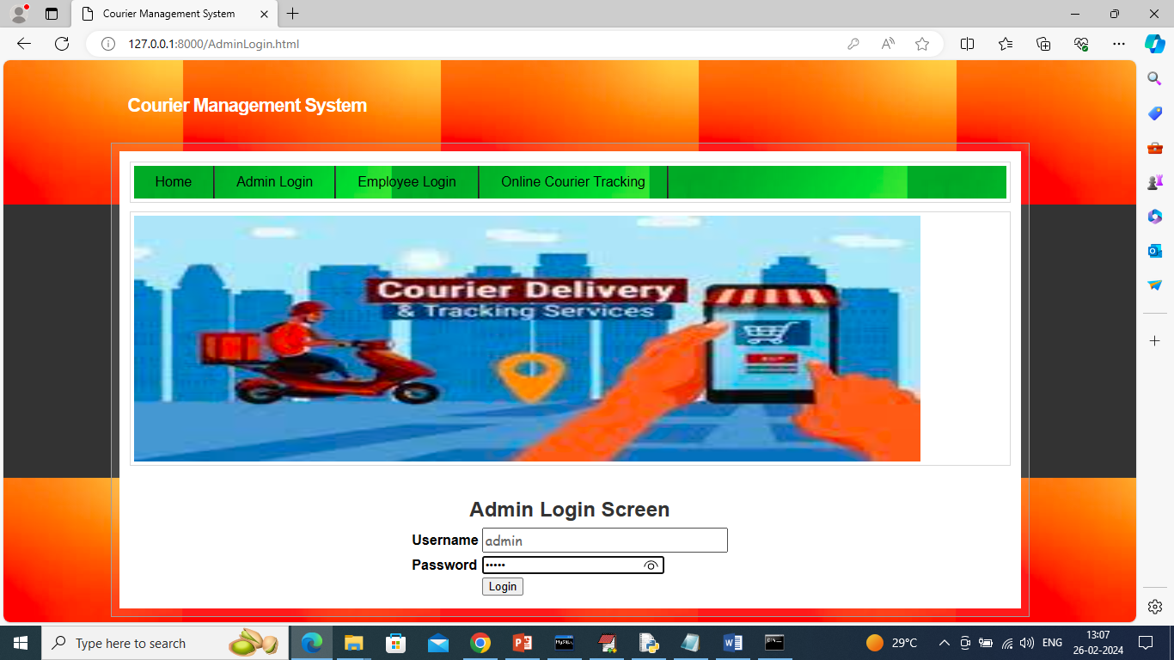
ADMIN LOGIN SCREEN:

Slide 21
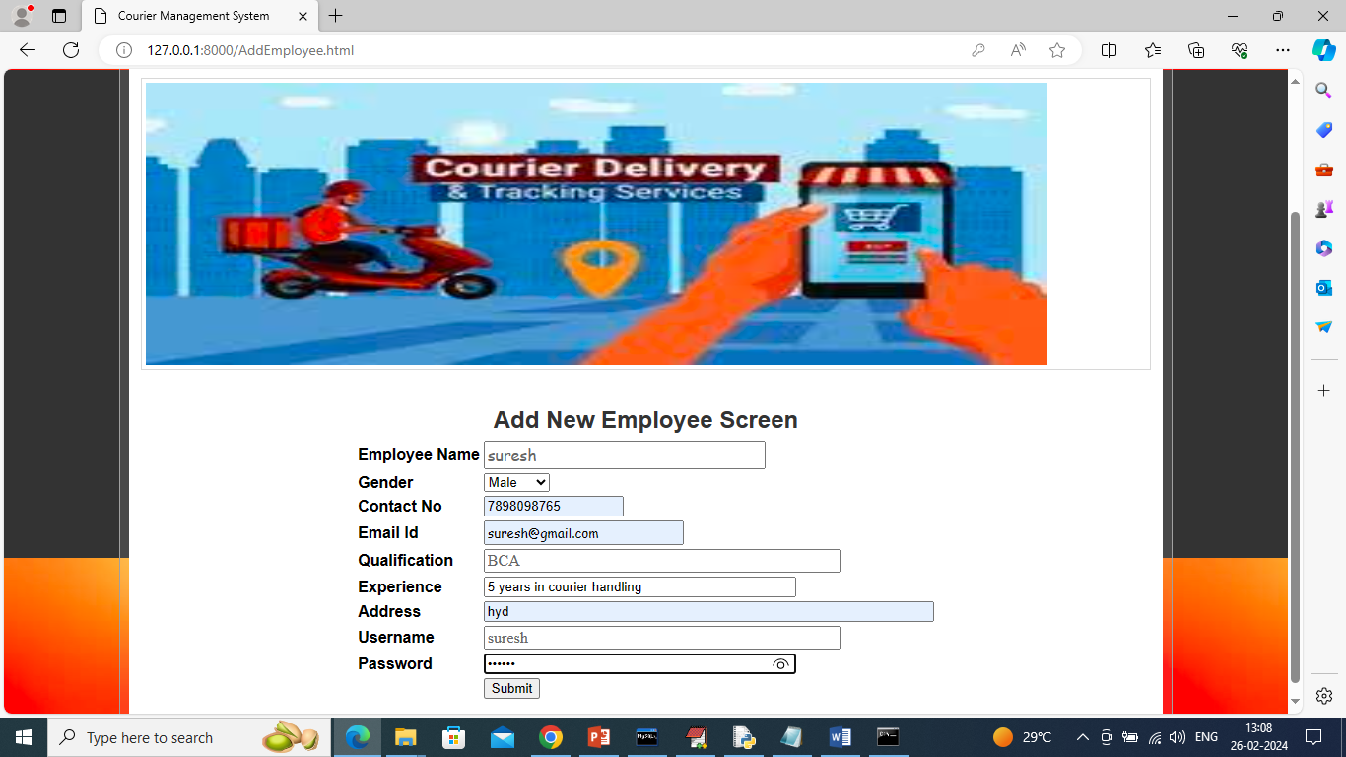
EMPLOYEE SCREEN:

Slide 22
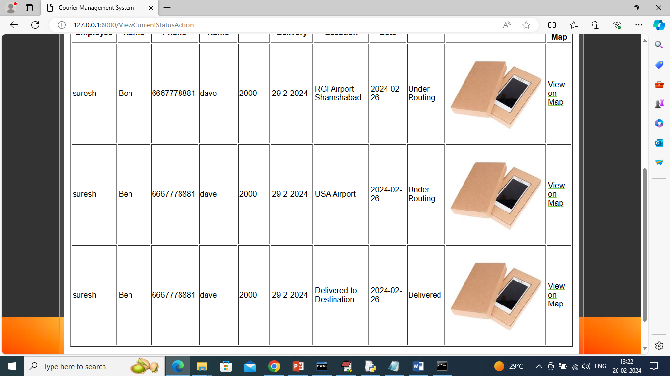
COURIER STATUS SCREEN:

Slide 23
CONCLUSION
The Courier Management System streamlines and automates the entire courier process, enhancing efficiency, accuracy, and user satisfaction.
By digitizing core functions such as booking, tracking, delivery updates, and payment handling, the system reduces manual errors and saves time for both service providers and customers.

Slide 24
FUTURE OF SCOPE
The future of Courier Management Systems is highly promising, with increasing demand for fast, reliable, and tech-driven logistics solutions. Some potential areas of growth include:
AI and Machine Learning Integration:
Route optimization, delivery time prediction, and customer behavior analysis can be enhanced using intelligent algorithms.
Mobile App Expansion:
Fully functional mobile apps for customers, drivers, and admins will enable better user experience and real-time communication.

Slide 25
Thank you

